Slide 1
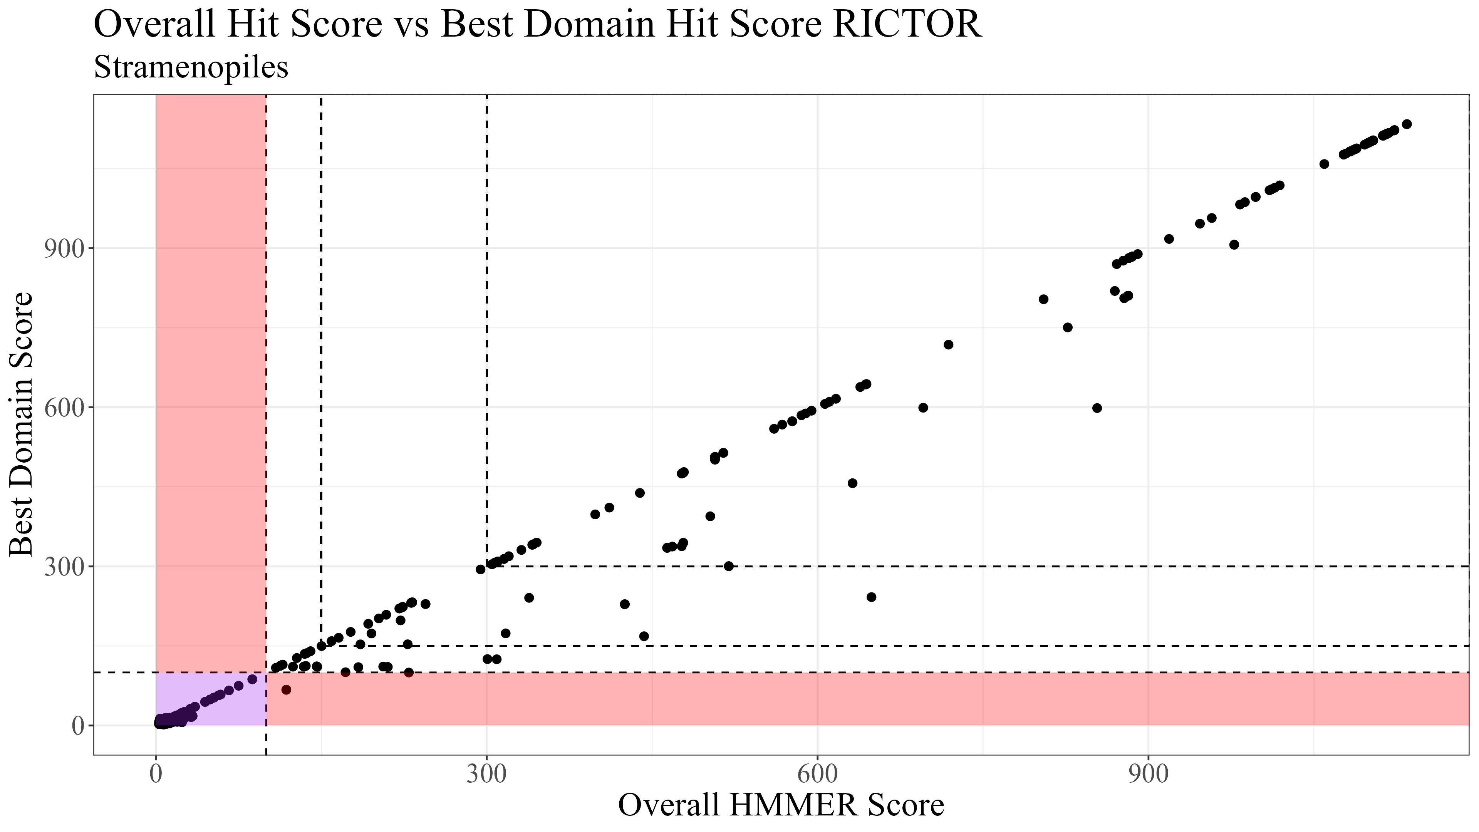
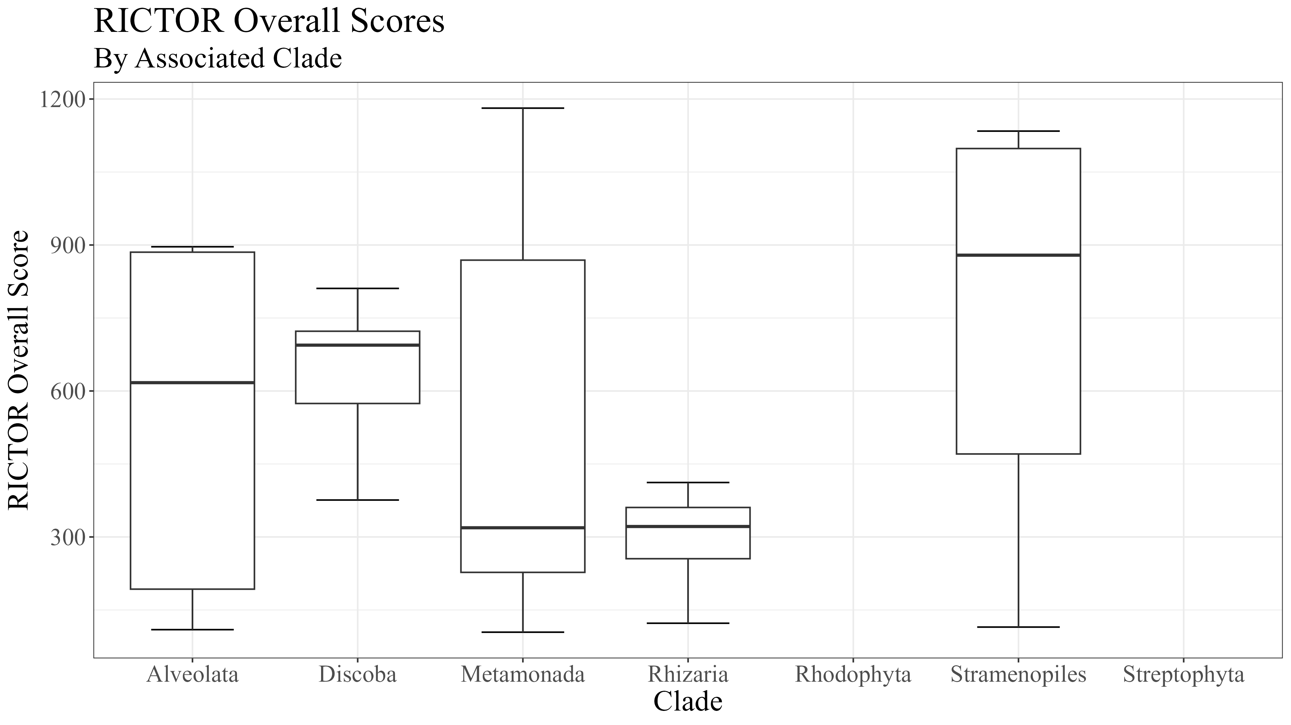
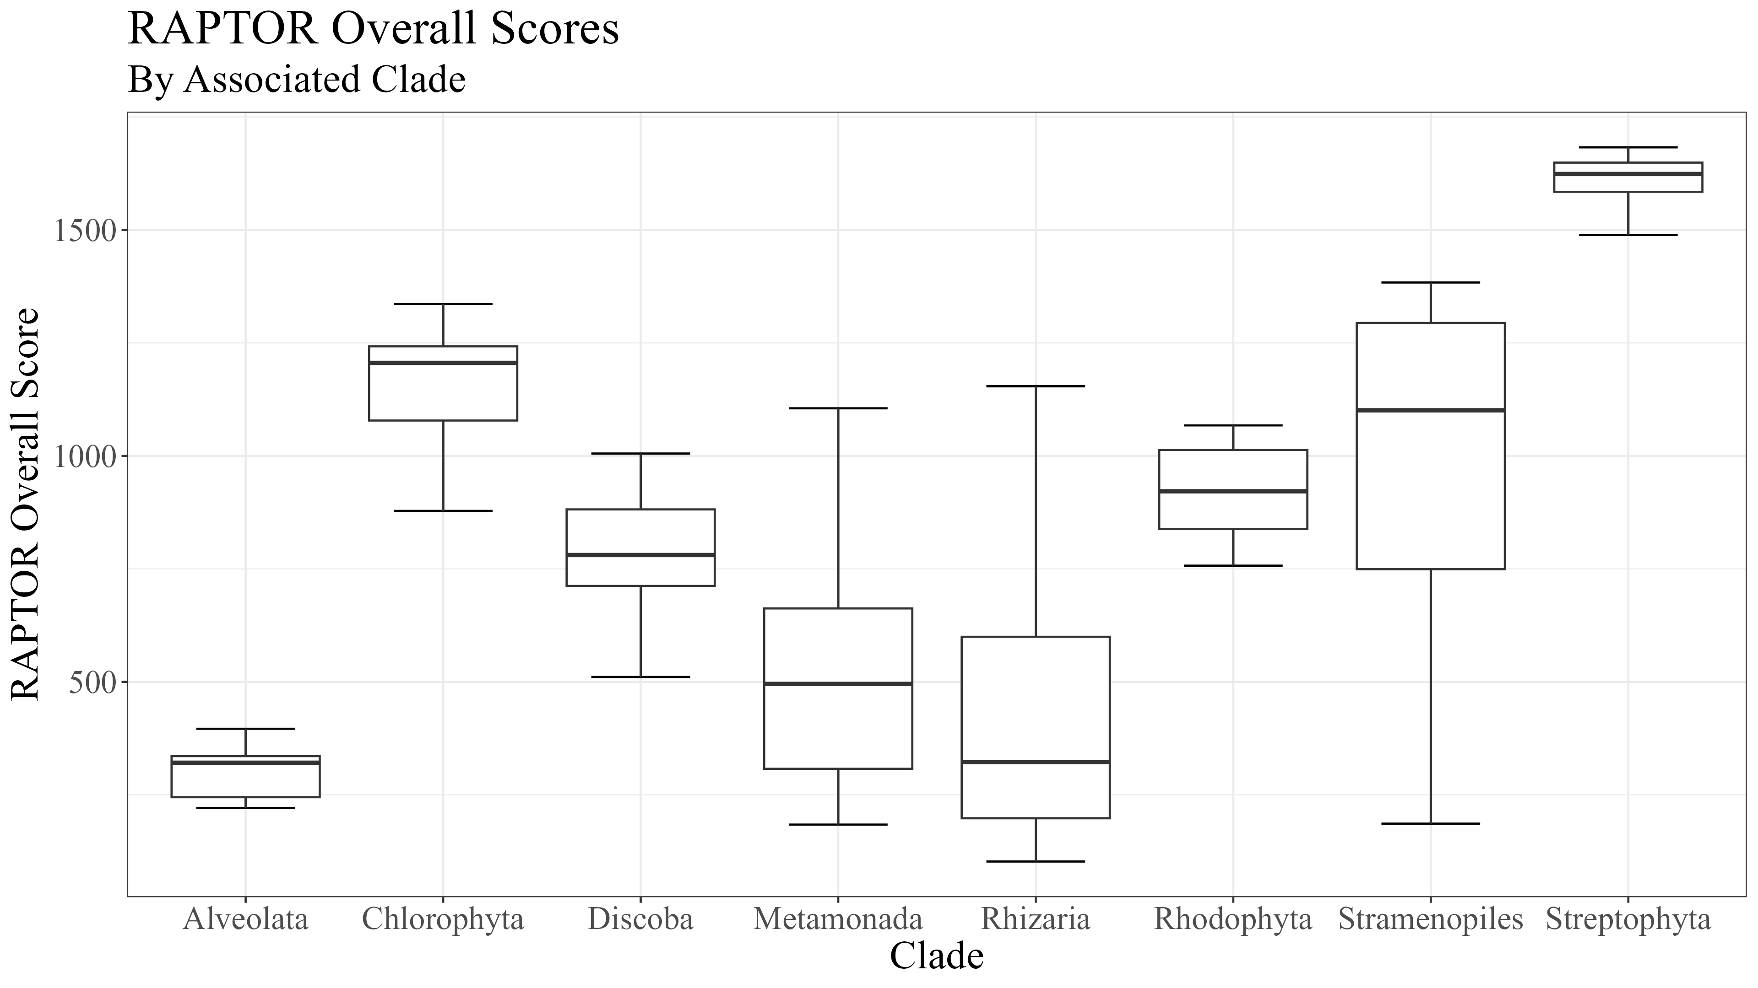
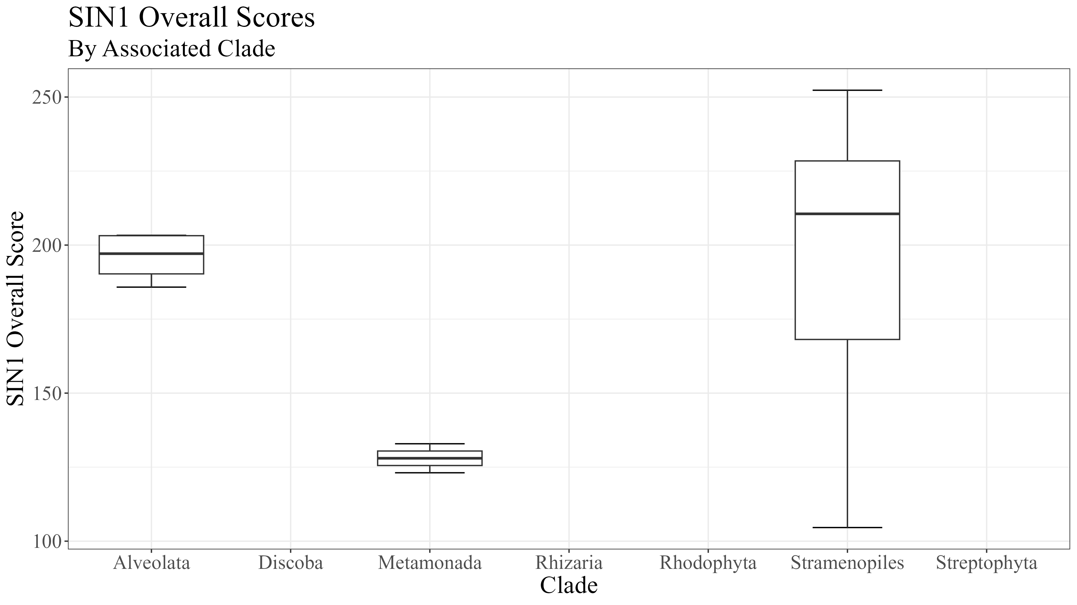
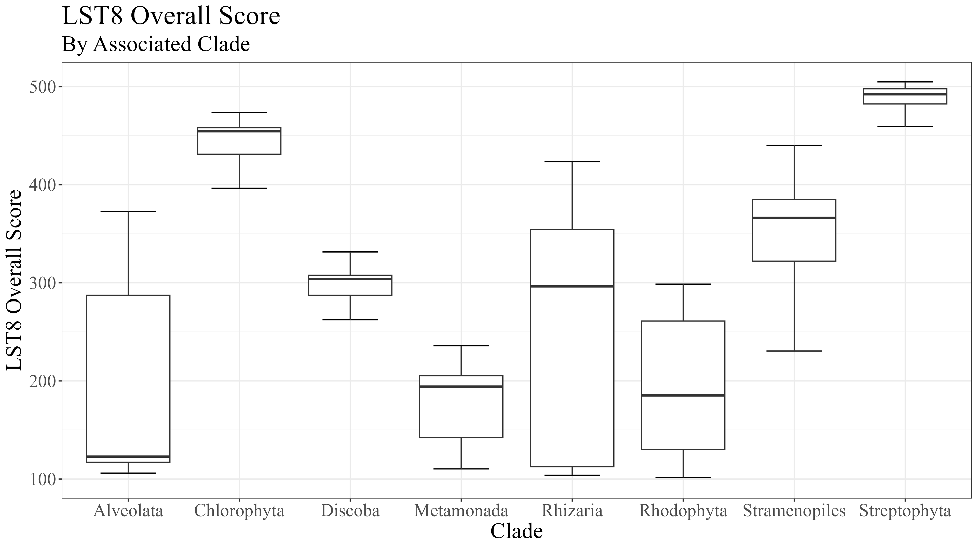
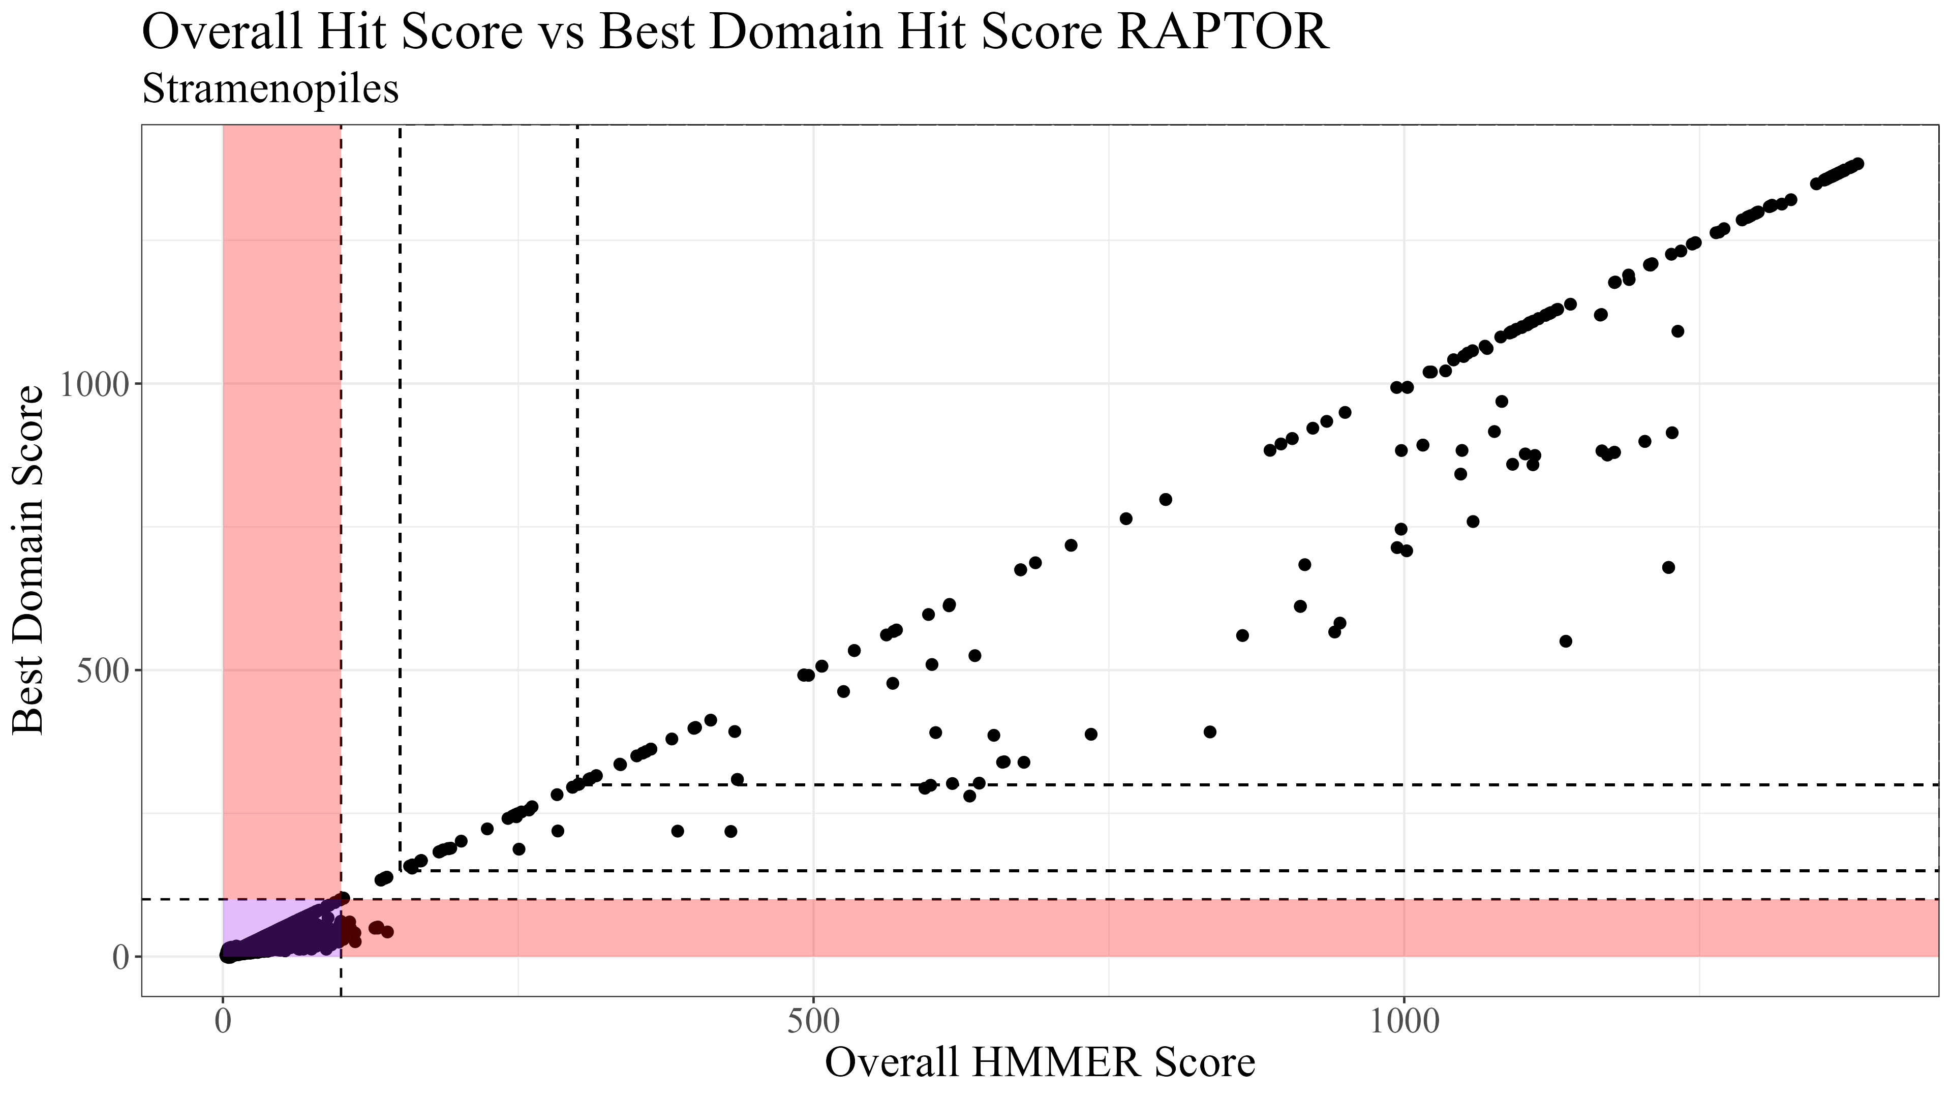
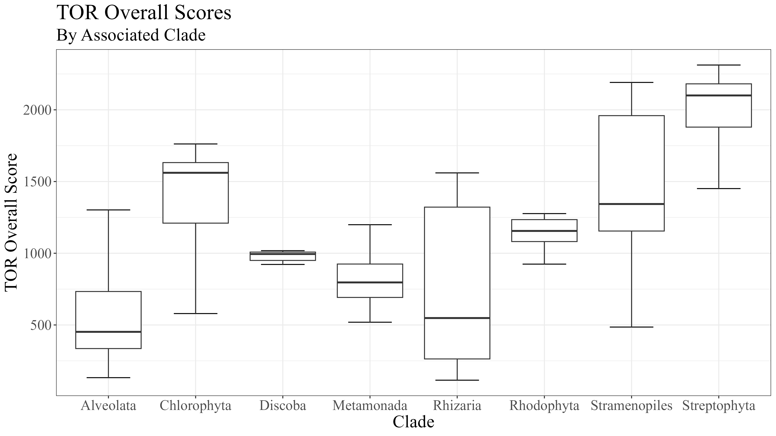
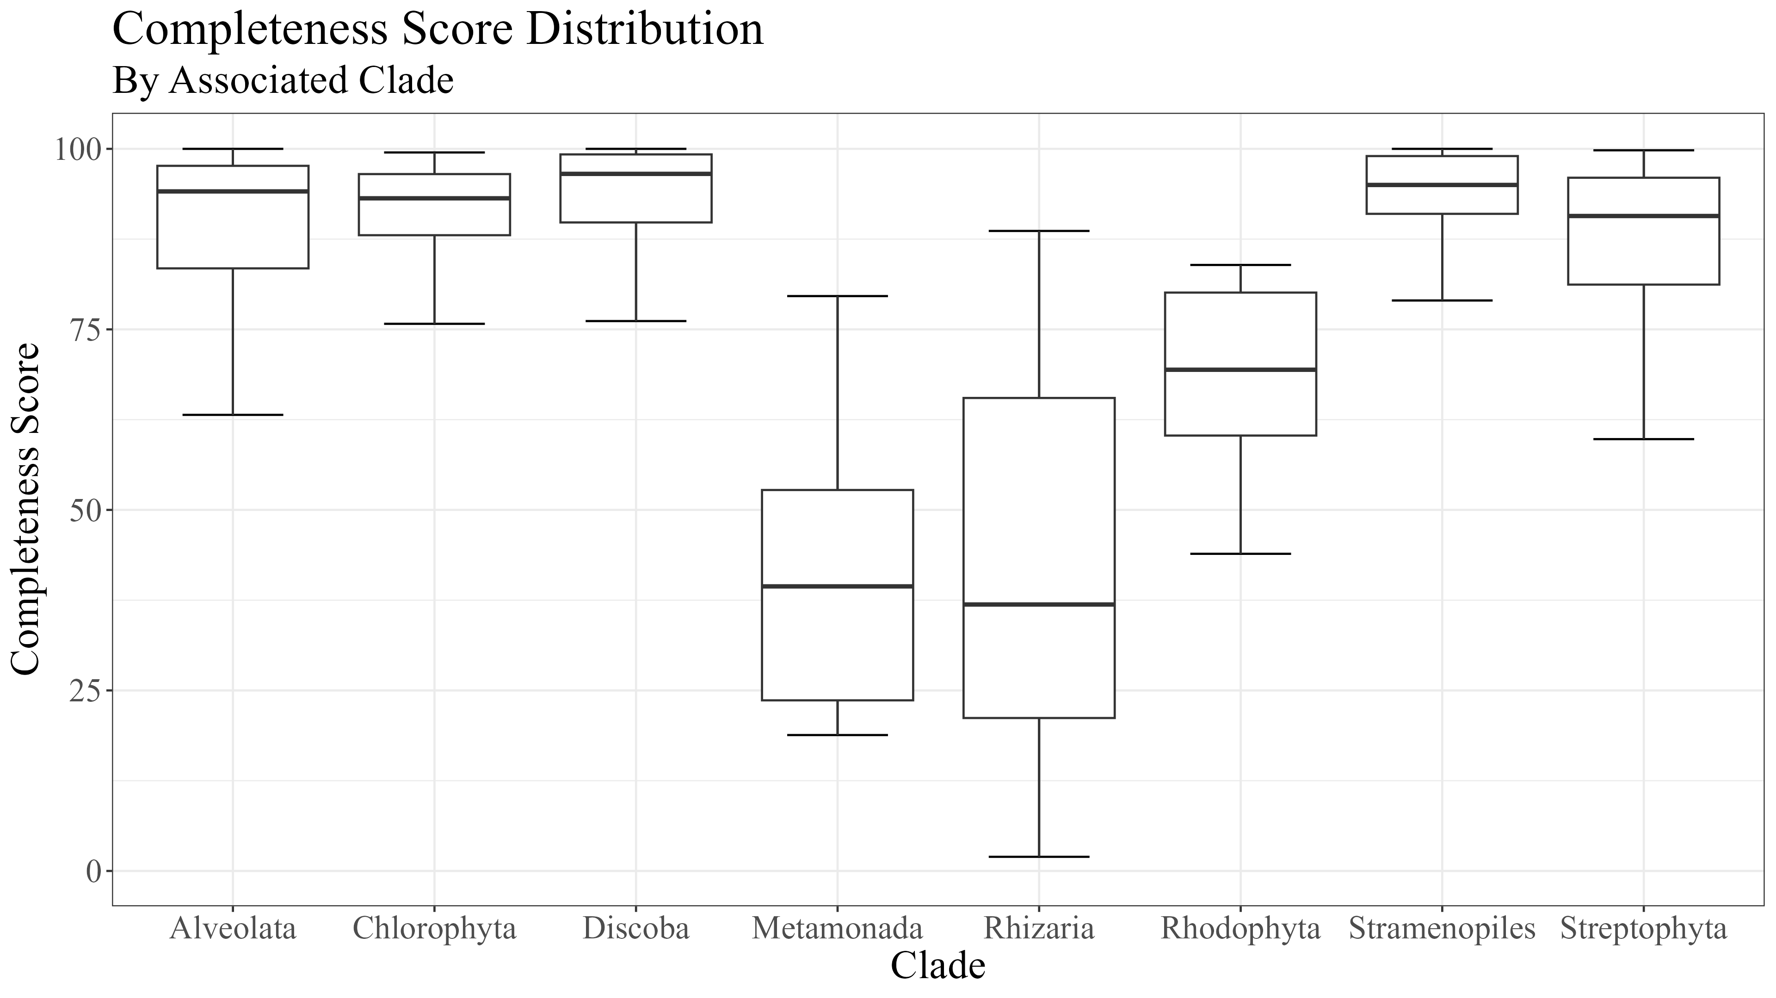
Supplemental 7
(A)
(B)
Notes:
Supplemental 1 (Need to Include HMMER Results here)

Slide 2




Supplemental 2
RICTOR
(A)
RAPTOR
(B)
N
N
RICTORN
RAPTORN
Reference
Reference
High
RICTORM
ARM
High
Medium
RasGEF
HEAT
Low
Medium
Dom5
ARM
Reference
Reference
RICTOR
Phosphor
WD-40
High
High
Medium
Medium
Low
C
C
Notes:
Supplemental 2 (MSA for RICTOR and RAPTOR)

Slide 3

Supplemental 3
SIN1
RICTOR
RAPTOR
LST8
TOR
Completeness Score
100
Leishmania braziliensis MHOM/BR/75/M2904
Leishmania naiffi
Leishmania panamensis
75
Leishmania shawi
Leishmania lindenbergi
Leishmania utingensis
50
Leishmania donovani
Leishmania infantum JPCM5
Leishmania major strain Friedlin
25
Discoba
Leishmania mexicana MHOM/GT/2001/U1103
Leishmania martiniquensis
Leishmania enriettii
Leishmania orientalis
Leishmania sp. Namibia
HMMER Score
Leishmania sp. Ghana 2012 LV757
Leishmania tarentolae
Leptomonas seymouri
Leptomonas pyrrhocoris
H
Porcisia hertigi
Trypanosoma cruzi marinkellei
M
Trypanosoma cruzi cruzi
Trypanosoma cruzi Dm28c
Trypanosoma equiperdum
L
Trypanosoma brucei brucei TREU927
Trypanosoma brucei gambiense DAL972
P
Trypanosoma vivax
Trypanosoma theileri
Trypanosoma grayi
ABS
Trypanosoma conorhini
Trypanosoma melophagium
Angomonas deanei
Metabolic Strategy
Phytomonas sp. Hart1
Phytomonas sp. EM1
Bodo saltans
Diplonema papillatum
Autotrophic
Naegleria gruberi
Naegleria fowleri
Heterotroph
Naegleria lovaniensis
Acrasis kona
Giardia intestinalis ATCC 50581
Mixotroph
Metamonada
Giardia lamblia P15
Giardia intestinalis assemblage B
Plastid Parasite
Giardia muris
Carpediemonas membranifera
Kipferlia bialata
Non-Plastid Parasite
Histomonas meleagridis
Tritrichomonas foetus
Tritrichomonas musculus
Endosymbiotic
Trichomonas vaginalis G3
Anaeramoeba ignava
Anaeramoeba flamelloides
Blattamonas nauphoetae
Barthelona sp. PCE
Notes:
Supplemental (3)

Slide 4
Supplemental 4
SIN1
RICTOR
RAPTOR
LST8
TOR
Cylindrotheca closterium
Completeness Score
Nitzschia inconspicua
Nitzschia putrida
Pseudo-nitzschia multiseries
100
Pseudo-nitzschia multistriata
Fragilariopsis cylindrus CCMP1102
Entomoneis
Phaeodactylum tricornutum CCAP 1055/1
Seminavis robusta
Fistulifera solaris
75
Mayamaea pseudoterrestris
Cyclotella cryptica
Thalassiosira oceanica CCMP1005
Thalassiosira pseudonana CCMP1335
Conticribra weissflogii
Skeletonema marinoi
50
Chaetoceros tenuissimus
Fragilaria crotonensis
Ectocarpus siliculosus
Ectocarpus sp. CCAP 1310/34
Cladosiphon okamuranus
Nemacystus decipiens
25
Alaria esculenta
Undaria pinnatifida
Macrocystis pyrifera
Saccharina japonica
Sargassum fusiforme
Tribonema minus
Pelagomonas calceolata
Aureococcus anophagefferens
Chrysophaeum taylorii
HMMER Score
Pelagophyceae sp. CCMP2097
Paraphysomonas imperforata
Ochromonas sp. CCMP1393
Vischeria
Nannochloropsis sp.
Nannochloropsis gaditana CCMP526
H
Nannochloropsis oceanica
Nannochloropsis salina CCMP1776
Monodopsis
Triparma columacea
Triparma strigata
M
Triparma verrucosa
Triparma laevis f. inornata
Triparma laevis f. longispina
Triparma retinervis
Tetraparma gracilis
L
Parmales sp. scaly parma
Stramenopiles
Bremia lactucae
Plasmopara halstedii
Phytophthora capsici
P
Phytophthora cinnamomi var. cinnamomi
Phytophthora infestans T30-4
Phytophthora nicotianae CJ01A1
Phytophthora nicotianae P10297
Phytophthora nicotianae P1569
ABS
Phytophthora nicotianae P1976
Phytophthora megakarya
Phytophthora palmivora
Phytophthora cactorum
Phytophthora fragariae
Phytophthora idaei
Metabolic Strategy
Phytophthora sojae
Phytophthora boehmeriae
Phytophthora rubi
Phytophthora ramorum
Phytophthora kernoviae 00238/432
Phytophthora aleatoria
Autotrophic
Peronospora destructor
Peronospora farinosa
Peronospora effusa
Peronospora belbahrii
Peronospora matthiolae
Heterotroph
Hyaloperonospora brassicae
Hyaloperonospora arabidopsidis Emoy2
Lagenidium giganteum
Pythium oligandrum
Pythium insidiosum
Mixotroph
Globisporangium splendens
[Pythium] brassicae (nom. inval.)
Albugo candida
Thraustotheca clavata
Aphanomyces euteiches
Plastid Parasite
Aphanomyces astaci
Aphanomyces cochlioides
Aphanomyces invadans
Saprolegnia parasitica CBS 223.65
Non-Plastid Parasite
Saprolegnia diclina VS20
Achlya hypogyna
Blastocystis sp. ATCC 50177/Nand II
Blastocystis sp. subtype 4
Blastocystis sp. Blastoise
Endosymbiotic
Blastocystis sp. BT1
Blastocystis sp. DL
Blastocystis sp. JDR
Blastocystis sp. NMH
Aplanochytrium kerguelense
Aurantiochytrium limacinum ATCC MYA-1381
Schizochytrium aggregatum ATCC 28209
Hondaea fermentalgiana
Hyphochytrium catenoides
Notes:
Supplemental Stramenopiles

Slide 5
Supplemental 5
SIN1
RICTOR
RAPTOR
LST8
TOR
Perkinsus olseni
Completeness Score
Perkinsus chesapeaki
Perkinsus marinus ATCC 50983
Symbiodinium microadriaticum
Symbiodinium sp. KB8
100
Symbiodinium sp. CCMP2592
Symbiodinium natans
Durusdinium trenchii
Breviolum minutum
Cladocopium goreaui
Alveolata
Effrenium voratum
Fugacium kawagutii
Polarella glacialis
75
Amoebophrya sp. AT5.2
Amoebophrya sp. A120
Chromera velia CCMP2878
Vitrella brassicaformis CCMP3155
Eimeria acervulina
Eimeria tenella
Eimeria maxima
Eimeria brunetti
50
Cyclospora cayetanensis
Cryptosporidium parvum Iowa II
Cryptosporidium felis
Cryptosporidium meleagridis
Cryptosporidium andersoni
Cryptosporidium canis
Cryptosporidium hominis
Cryptosporidium bovis
25
Cryptosporidium muris RN66
Cryptosporidium ryanae
Cryptosporidium xiaoi
Cryptosporidium tyzzeri
Cryptosporidium ubiquitum
Cryptosporidium sp. chipmunk genotype I
Cryptosporidium sp. 43IA8
Toxoplasma gondii VEG
Toxoplasma gondii GT1
Toxoplasma gondii ME49
Toxoplasma gondii VAND
Toxoplasma gondii RUB
HMMER Score
Toxoplasma gondii MAS
Toxoplasma gondii p89
Toxoplasma gondii CAST
Toxoplasma gondii FOU
Toxoplasma gondii ARI
Toxoplasma gondii GAB2-2007-GAL-DOM2
Toxoplasma gondii TgCatPRC2
Besnoitia besnoiti
H
Hammondia hammondi
Cystoisospora suis
Neospora caninum Liverpool
Gregarina niphandrodes
Porospora cf. gigantea A
Plasmodium berghei ANKA
M
Plasmodium chabaudi adami
Plasmodium chabaudi chabaudi
Plasmodium vinckei vinckei
Plasmodium vinckei brucechwatti
Plasmodium vinckei lentum
Plasmodium vinckei petteri
L
Plasmodium yoelii yoelii
Plasmodium yoelii 17X
Plasmodium brasilianum
Plasmodium knowlesi strain H
Plasmodium vivax Brazil I
Plasmodium vivax North Korean
P
Plasmodium vivax Mauritania I
Plasmodium vivax India VII
Plasmodium fragile
Plasmodium malariae
Plasmodium ovale curtisi
Plasmodium ovale wallikeri
Plasmodium gonderi
ABS
Plasmodium cynomolgi strain B
Plasmodium inui San Antonio 1
Plasmodium falciparum CAMP/Malaysia
Plasmodium falciparum NF54
Plasmodium falciparum 3D7
Plasmodium falciparum 7G8
Plasmodium falciparum Dd2
Plasmodium falciparum Palo Alto/Uganda
Metabolic Strategy
Plasmodium falciparum HB3
Plasmodium falciparum RAJ116
Plasmodium falciparum IGH-CR14
Plasmodium falciparum Vietnam Oak-Knoll (FVO)
Plasmodium falciparum FCH/4
Plasmodium falciparum Tanzania (2000708)
Plasmodium falciparum NF135/5.C10
Autotrophic
Plasmodium falciparum MaliPS096_E11
Plasmodium falciparum UGT5.1
Plasmodium reichenowi
Plasmodium gaboni
Plasmodium sp. DRC-Itaito
Plasmodium sp. gorilla clade G1
Plasmodium sp. gorilla clade G2
Heterotroph
Plasmodium sp. gorilla clade G3
Plasmodium gallinaceum
Plasmodium relictum
Hepatocystis sp. ex Piliocolobus tephrosceles
Babesia bigemina
Babesia ovis
Mixotroph
Babesia caballi
Babesia gibsoni
Babesia ovata
Babesia duncani
Babesia sp. Xinjiang
Babesia bovis T2Bo
Plastid Parasite
Babesia microti strain RI
Theileria annulata
Theileria orientalis strain Shintoku
Theileria parva strain Muguga
Theileria equi strain WA
Cardiosporidium cionae
Non-Plastid Parasite
Paramecium primaurelia
Paramecium tetraurelia strain d4-2
Paramecium octaurelia
Paramecium pentaurelia
Paramecium sonneborni
Ichthyophthirius multifiliis
Tetrahymena thermophila SB210
Endosymbiotic
Pseudocohnilembus persalinus
Stylonychia lemnae
Oxytricha trifallax
Rhizaria
Blepharisma stoltei
Plasmodiophora brassicae
Bonamia ostreae
Reticulomyxa filosa
Lotharella oceanica
Bigelowiella natans CCMP2755
Paulinella micropora
Notes:
Supplemental Alveolata/Rhizaria

Slide 6
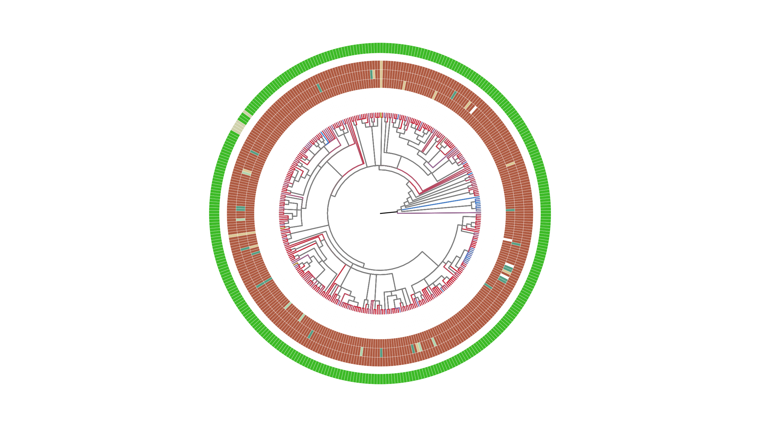
Supplemental 6
SIN1
Completeness Score
RICTOR
RAPTOR
LST8
TOR
100
Chondrus crispus
Streptophyta
Gracilaria domingensis
75
Gracilariopsis chorda
Cyanidium caldarium
Cyanidioschyzon merolae strain 10D
Rhodophyta
Cyanidiococcus yangmingshanensis
Porphyra umbilicalis
50
Pyropia yezoensis
Pyropia vietnamensis
Porphyridium purpureum
Galdieria partita
Galdieria sulphuraria
Galdieria yellowstonensis
Rhodosorus marinus
25
Dunaliella salina
Chlamydomonas reinhardtii
Chlamydomonas incerta
Chlamydomonas eustigma
Chlamydomonas sp. UWO 241
Chlamydomonas schloesseri
Chloromonas remiasii
Sanguina aurantia
Microglena sp. YARC
Volvox carteri f. nagariensis
HMMER Score
Volvox africanus
Volvox reticuliferus
Gonium pectorale
Pleodorina starrii
Haematococcus lacustris
Edaphochlamys debaryana
H
Astrephomene gubernaculifera
Tetrabaena socialis
Limnomonas spitsbergensis
Scenedesmus sp. NREL 46B-D3
Scenedesmus sp. PABB004
M
Tetradesmus obliquus
Tetradesmus deserticola
Enallax costatus
Flechtneria rotunda
Desmodesmus armatus
L
Chromochloris zofingiensis
Monoraphidium minutum
Monoraphidium neglectum
Raphidocelis subcapitata
Chlorella sorokiniana
P
Chlorella vulgaris
Chlorella variabilis
Chlorella desiccata (nom. nud.)
Chlorella sp. A99
ABS
Chlorophyta
Chlorella ohadii
Auxenochlorella protothecoides
Prototheca wickerhamii
Micractinium conductrix
Apatococcus lobatus
Apatococcus fuscideae
Helicosporidium sp. ATCC 50920
Metabolic Strategy
Chlorellaceae sp.
Symbiochloris reticulata
Symbiochloris irregularis
[Myrmecia] bisecta
Asterochloris sp. Cgr/DA1pho
Trebouxia sp. A1-2
Autotrophic
Trebouxia sp. C0004
Trebouxia sp. C0005
Trebouxia sp. C0006
Trebouxia sp. C0009 RCD-2024
Trebouxia sp. C0010 RCD-2024
Heterotroph
Coccomyxa subellipsoidea C-169
Coccomyxa viridis
Coccomyxa elongata
Coccomyxa sp. Obi
Elliptochloris bilobata
Mixotroph
Botryococcus braunii Showa
Picochlorum sp. SENEW3
Picochlorum sp. soloecismus
Picochlorum sp. BH-2019
Picochlorum sp. BPE23
Plastid Parasite
RAPTOR
LST8
TOR
Pedinomonas minor
Pedinophyceae sp. YPF-701
Tetraselmis striata
Micromonas commoda
Micromonas pusilla CCMP1545
Non-Plastid Parasite
Bathycoccus prasinos RCC1105
Ostreococcus tauri
Ostreococcus lucimarinus CCE9901
Pycnococcus provasolii
Ostreobium quekettii
Endosymbiotic
Caulerpa lentillifera
Bryopsis sp. KO-2023
Ulva mutabilis
Notes:
Supplemental Archaeplastida

Slide 7
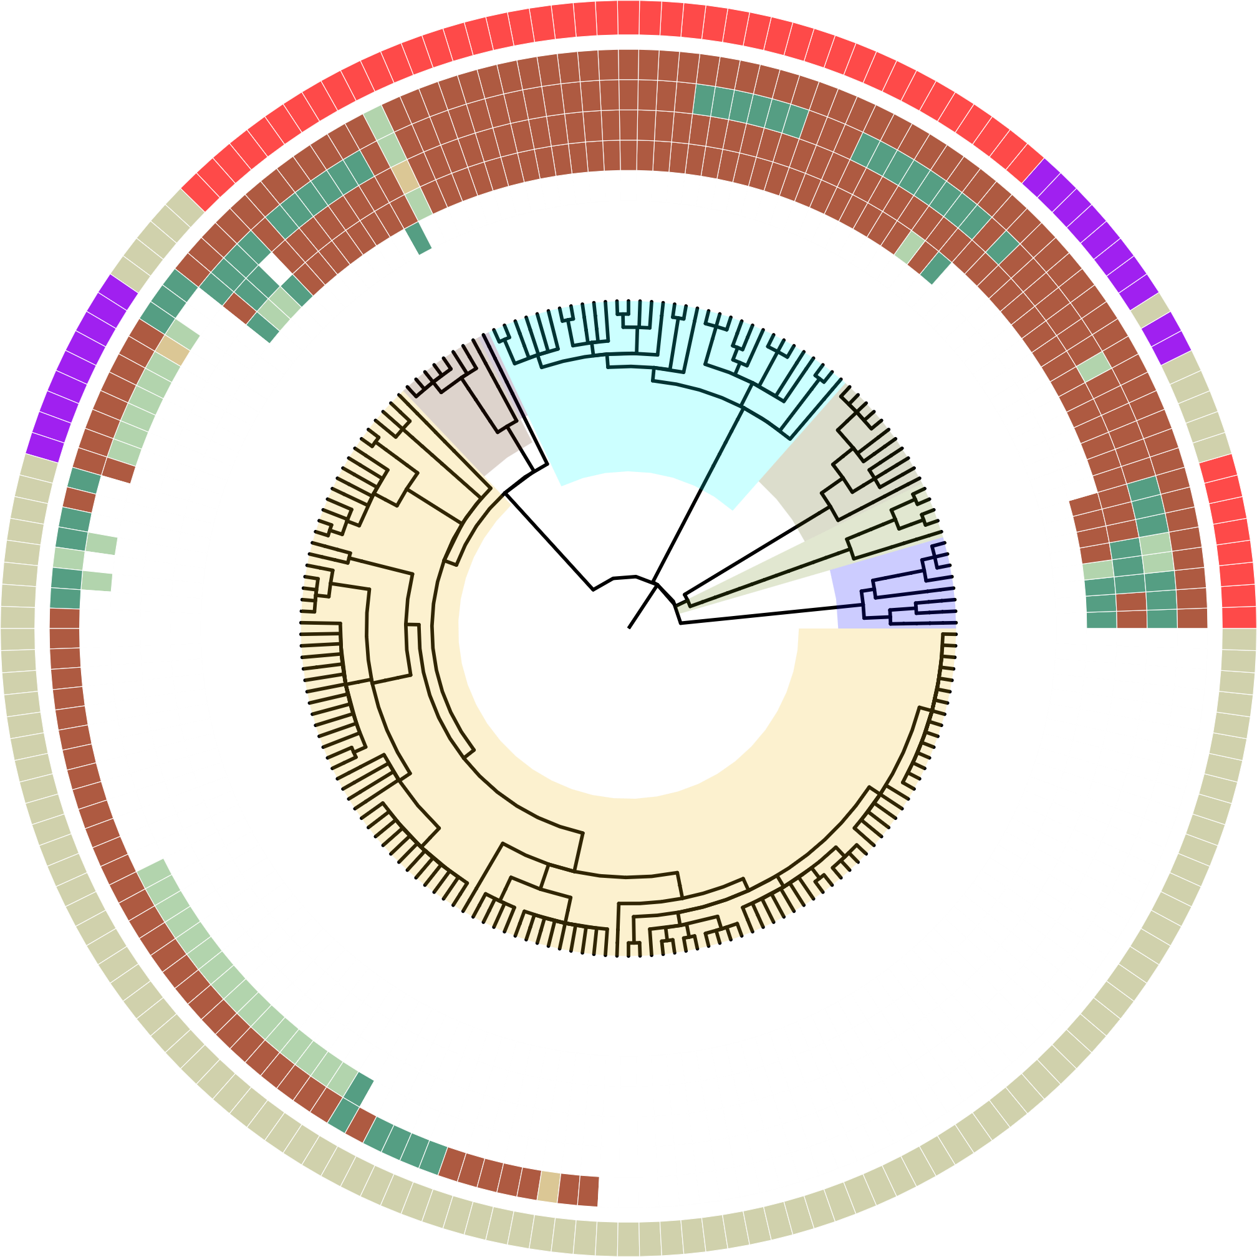
Supplemental 7
HMMER Score
H
M
L
P
ABS
Super Group
Alveolata
Stramenopiles
Rhizaria
Streptophyta
Chlorophyta
Discoba
Metamonada
Metabolic Strategy
Plastid Parasite
Non-Plastid Parasite
Endosymbiotic
Notes:
Early Prototype, just getting the style of the tree down first (Supplemental for Endosymbiotes/Parasites)

